Slide 1


Updates 5/5/20
Akash Levy

Slide 2

Overview
New BL/WL sweep with 100 cells
Sigma-mu and sigma-median plots
SDR fixed implementation
Optimization of ISPP
Optimal BL/WL voltages for FPPV and SDR
Finalized PW plot

Slide 3
Finalized PW Plot

Slide 4

New BL/WL Sweeps
NOTE: >2𝜎 outliers removed

Slide 5

Sigma-Mu Plot
METHODOLOGY:
Filter data for 1.5 V < BLV ≤ 3 V
Filter data for 2 V < WLV ≤ 3 V
Filter data for PW = 100ns
Group by WLV and BLV
Remove outliers based on 2σ
Find non-dominated front (pareto front)
3rd-order polynomial fit to pareto front
$σ=−2.27×{10}^{−10}μ^{3}−1.96×{10}^{−5}μ^{2}+0.194μ−1012$

Slide 6

Sigma-Median Plot
METHODOLOGY:
Filter data for 1.5 V < BLV ≤ 3 V
Filter data for 2 V < WLV ≤ 3 V
Filter data for PW = 100ns
Group by WLV and BLV
Remove outliers based on 2σ
Find non-dominated front (pareto front)
4th-order polynomial fit to pareto front
$σ=−1.34×{10}^{−14}μ^{4}−2.02×{10}^{−9}μ^{3}+9.54×{10}^{−5}μ^{2}+0.826μ−3307$
This means the data is skewed! Looking at median, we can reformulate resistance ranges

Slide 7
Optimal BL/WL from pareto front
 | BLV (V) | WLV (V)
Range 0 | 3.3 | 3
Range 1 | 1.75 | 2.84
Range 2 | 2.9 | 2.65
Range 3 | 2.7 | 2.58
Range 4 | 3 | 2.48
Range 5 | 2.5 | 2.42
Range 6 | 2.75 | 2.3
Range 7 | N/A | N/A

Slide 8
SDR Fixed Implementation
RESET pulse
Check if in range
Optimal SET pulse
Check if in RMM range, else restart
RMM defined by RM of level above and Rm of level below
SET tuning if resistance too high, RESET tuning if resistance too low
Sweep up BLV for SET
Sweep up SLV for RESET
Restart if fail

Slide 9
ISPP Algorithm
Start with WLV = 2.1V
Increase WLV by step size
Pulse until in range, RESET if gone past
Step size swept from 0.01V to 0.15V
Key metrics
Avg. # of attempts needed
Avg. # of total pulses needed
(Distribution of pulses needed)
(Per bin and overall)
Best step size: 0.06V, success: 99.85%
Mean pulses: 9.63, Stdev pulses: 9.09
Mean resets: 2.13, Stdev resets: 2.26

Slide 10
ISPP Algorithm
Start with WLV = 2.1V
Increase WLV by step size
Pulse until in range, RESET if gone past
Step size swept from 0.01V to 0.15V
Key metrics
Avg. # of attempts needed
Avg. # of total pulses needed
(Distribution of pulses needed)
(Per bin and overall)
Best step size: 0.06V, success: 99.85%
Mean pulses: 9.63, Stdev pulses: 9.09
Mean resets: 2.13, Stdev resets: 2.26

Slide 11
ISPP Step Size Dependence

Slide 12
EAG Success Rates

Slide 13
EAG Pulse Counts

Slide 14
Backup Slides
New data with the 100 cells
Good figures for if we need to make the paper longer

Slide 15
FORMing
100 cells FORMed
PW = 1000ns, WL = 2V
BL voltage from 0-5V in steps of 0.05V
Aim for medium post-FORM resistance
Medium post-FORM resistance
6-7kOhm
No over-FORM, no under-FORM

Slide 16
Cell Cycling
300 cycles per cell (100 cells)
Two pulses per cycle per cell
SET pulse
PW=100ns, BLV=3.3V, WLV=3V
RESET pulse
PW=100ns, SLV=2.3V, WLV=4V
Maximum SET resistance across cells, minimized over all
Lower Bound: 5.16 kΩ

Slide 17
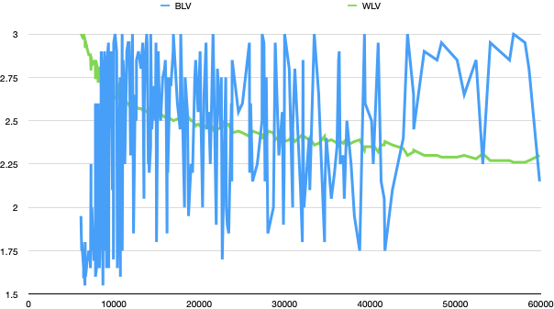
Pareto WL/BL Voltages

